Slide 1


ANALISI DI MERCATO 2022-2023
SIAFA 10/05/2023
Serena Alderisi
M.Sc. Data Scientist

Slide 2
Table of Contents
01
ANN parameters
02
ANN training
03
Use Case
04
Python script
Weights, bias, activation functions
Different training steps, Optimization problem and hyperparameters
California housing dataset Median house classification problem
Hands on a Multilayer perceptrons

Slide 3
ANN Assumptions
ANNs have been developed as generalizations of mathematical models of neural biology, based on the assumptions that:
1. Information processing occurs at many simple elements called neurons.
2. Signals are passed between neurons over connection links.
3. Each connection link has an associated weight, which, in typical neural net, multiplies the signal transmitted.
4. Each neuron applies an activation function to its net input to determine its output signal.

Slide 4
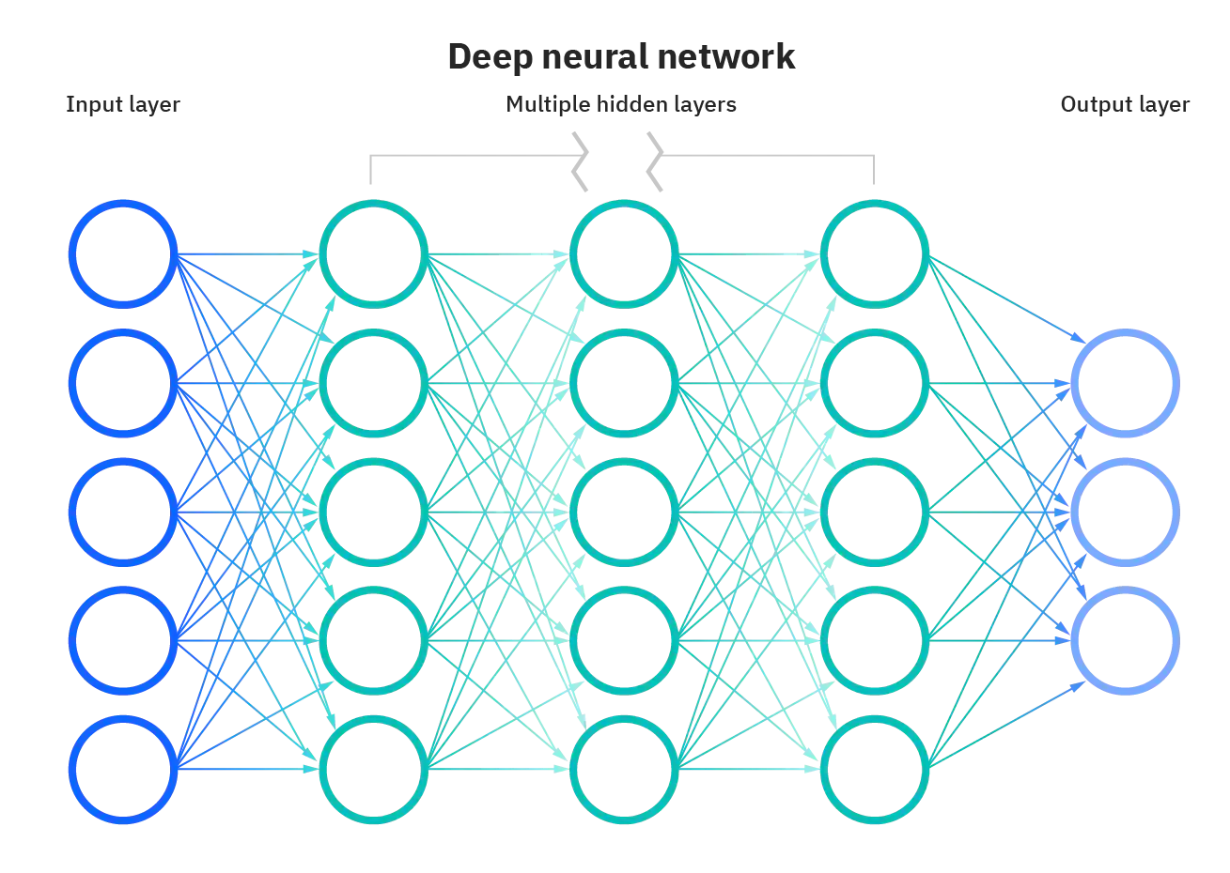
ANN Assumptions
A neural net consists of a large number of simple processing elements called neurons, units, cells or nodes.
Each neuron is connected to other neurons by means of directed communication links, each with associated weight.
The weight connect the neurons in the network.
Each neuron has an internal state, called its activation function or activity level, which is a function of the inputs it has received.
Typically, a neuron sends its activation as a signal to several other neurons.
It is important to note that a neuron can send only one signal at a time, although that signal is broadcast to several other neurons.
weights
weights
weights
activation
function
activation
function
activation
function
activation
function

Slide 5
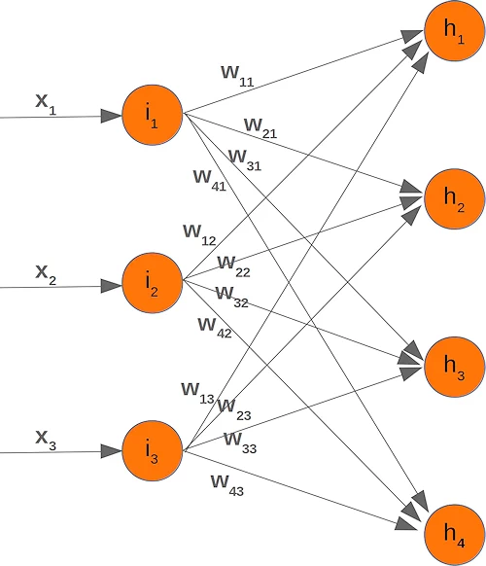
ANN Parameters
The weights represent the strength and direction of the connections between neurons and determine how much influence the output of one neuron has on the input of another.
Each connection between two neurons in an ANN is associated with a weight.
During the training phase of the ANN, the values of the weights are adjusted by an optimization algorithm, such as gradient descent, to improve the accuracy of the network's predictions.
The weights in an ANN depending on the complexity of the network, can be represented as a matrix of weights (called kernel), where each row corresponds to the weights of a neuron in the layer and each column corresponds to the weights of the inputs from the previous layer.
The values of the weights in an ANN are critical to the performance of the network.
If the weights are too small, the network may not have enough capacity to learn complex patterns in the data. On the other hand, if the weights are too large, the network may become unstable during training and lead to numerical instability issues such as exploding gradients.
The weights affect the network's ability to learn from data and make accurate predictions.

Slide 6
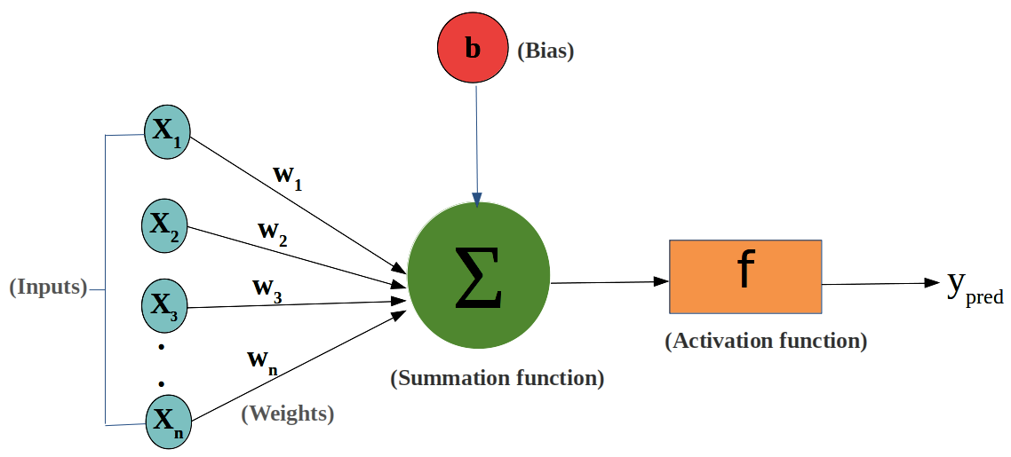
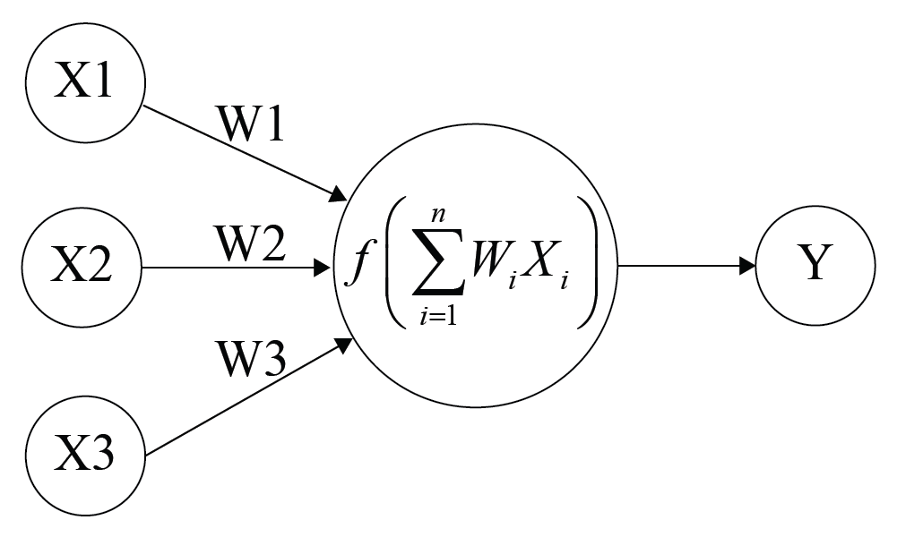
ANN Parameters
The bias is an additional parameter that is added to each neuron in the network, apart from the weights.
It’s a scalar value that is added to the weighted sum of inputs, before applying the activation function.
It helps the neurons to learn and make accurate predictions.
+ bias
The bias is an important parameter in ANN training, as it allows the model to better fit the training data by adjusting the activation function to better match the underlying patterns in the data.

Slide 7
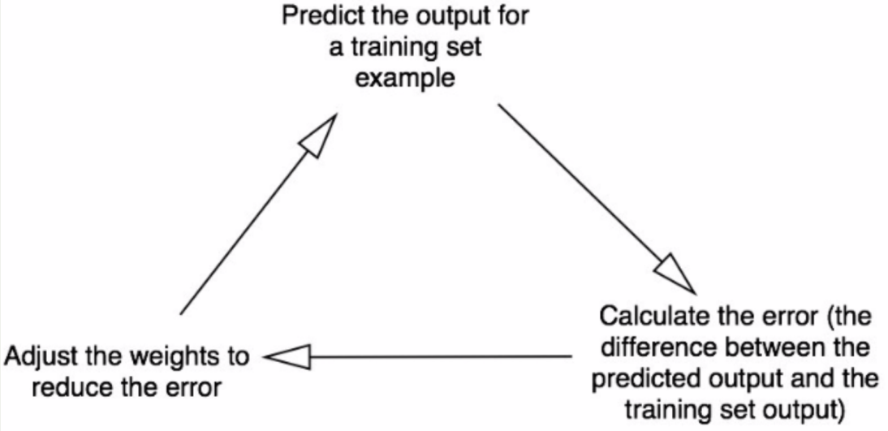
Training phase logic
The training process in an artificial neural network (ANN) involves adjusting the weights and biases of the network to minimize a loss function. The loss function measures the difference between the output of the neural network and the target output for a given input.
The training process can be computationally intensive and may require large amounts of data and computing resources. However, once the network is trained, it can be used to make predictions on new data that it has not seen before.

Slide 8






Training phase steps
INITIALIZATION
The weights and biases of the network are initialized to small random values.
FORWARD PROPAGATION
The input data is passed through the network, layer by layer, with each neuron in each layer calculating its output based on the inputs and the weights and biases of the neuron.
CALCULATION OF THE LOSS
The output of the last layer is compared with the target output, and the loss function is calculated. The goal is to minimize this loss function.
BACKPROPAGATION
The error is propagated back through the network, layer by layer, and the gradients of the weights and biases are calculated with respect to the loss function. This is done using the chain rule of differentiation.
WEIGHT AND BIAS UPDATE
The weights and biases are updated using an optimization algorithm, such as stochastic gradient descent, to minimize the loss function.
REPEAT
Steps 2-5 are repeated for multiple time (called epochs) until the loss function is minimized or until the validation error stops improving.

Slide 9

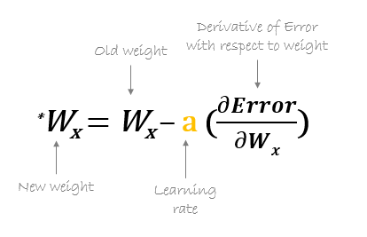
Optimization Problem
ANN TRAINING OPTIMIZATION PROBLEM
During the training the weights and biases of the neurons are adjusted to minimize a cost function that measures the error between the predicted output of the network and the actual output.
GRADIENT DISCENT
The gradient is an important concept in optimization, as it is used to find the minimum or maximum of a function. Specifically, in optimization, the gradient of a function is used to compute the direction of steepest descent (or ascent) at a given point.
The derivative of a function tells us the slope of the function itself at a given point
During training, the gradient of the loss function with respect to the model parameters (weights and bias) is computed, and the parameters are updated in the opposite direction of the gradient, so as to minimize the loss. This process is repeated iteratively until convergence, where the loss is minimized and the model has learned to make accurate predictions on new data.

Slide 10


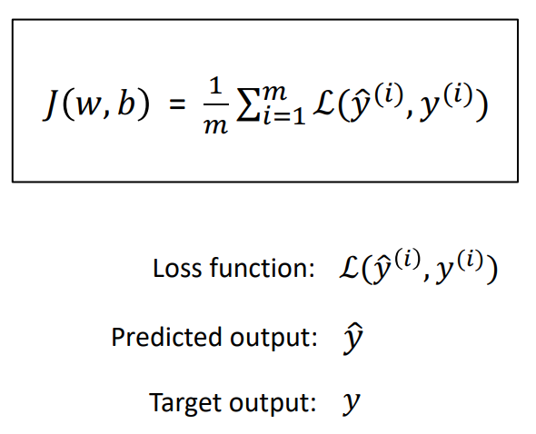
Gradient Descent
ANN TRAINING OPTIMIZATION PROBLEM
Adjust weights and bias in order to minimize the difference between the ANN output and the target variable
The gradient descent is used to update the weights and biases of the network based on the gradient of the loss function with respect to those parameters .
At a minimum of a function, the gradient is zero. This is because at a minimum, the function is not increasing in any direction, and hence the gradient, which gives the direction of maximum increase, must be zero. In other words, the slope of the function is zero at the minimum, which means that the gradient is also zero.
the cost function J(w) and the loss function L(w) both measure the difference between the predicted output of the network and the actual output, but the cost function is applied over the entire training dataset while the loss function is applied to a single training example.

Slide 11
Stochastic Gradient Descent (SGD)
SGD is a popular optimization algorithm used in machine learning for minimizing the cost function of a model.
The idea behind SGD is also to iteratively update the model's parameters based on the gradients of the cost function with respect to the parameters. Instead of using the entire dataset for each update, SGD randomly selects a subset (or batch) of the data to compute the gradient, which leads to faster convergence and better generalization performance.
There are different variants of gradient descent:
Batch gradient descent, where the gradient is computed over the entire training set, which can be computationally expensive for large datasets.
Stochastic gradient descent, where the gradient is computed for a single randomly selected training sample, which can be faster but can be more noisy.
Mini-batch gradient descent that is a compromise between the two.
The common goal is training the network to minimize the loss and make accurate predictions on new data.

Slide 12
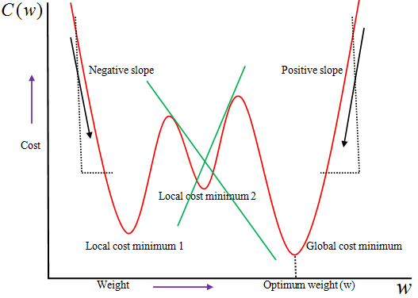
Local minimum problem
The problem of getting stuck in a local minimum occurs when the optimization algorithm used to update the weights and biases during training converges to a local optimum solution instead of the global minimum of the cost function.
A local minimum is a point in the parameter space of the ANN where the cost function has a lower value than its immediate neighbors, but the cost function has a higher value than the global minimum.
When the optimization algorithm gets stuck in a local minimum, it is unable to continue searching for better solutions, which can limit the performance of the network.
There are several strategies that can be used to overcome the problem of getting stuck in a local minimum, including:
Using different optimization algorithms that are less likely to get trapped in local minima, such as stochastic gradient descent with momentum, or other second-order optimization algorithms.
Adding regularization terms to the cost function, which can help prevent overfitting and reduce the chances of getting stuck in a local minimum.
Adding more layers to the network or increasing the number of neurons in each layer, which can increase the complexity and flexibility of the network and make it less likely to get stuck in a local minimum.
Using multiple initializations of the weights and biases, and selecting the best solution based on the performance on a validation set.

Slide 13
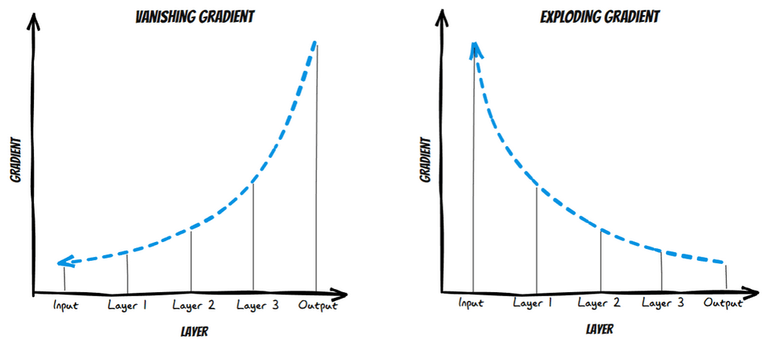
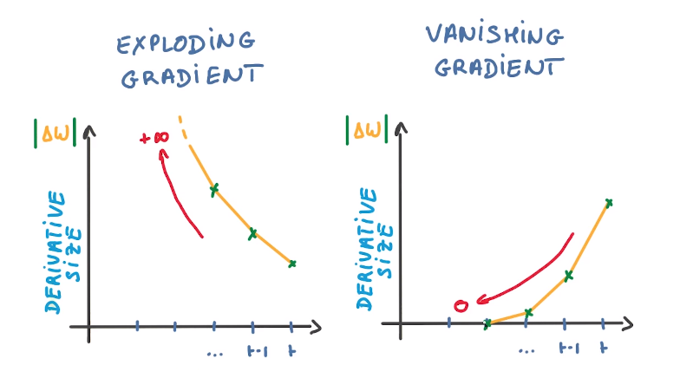
Vanishing and Exploding gradient
The vanishing gradient problem is a common issue that arises during training, particularly in deep neural networks with many layers.
The problem occurs when the gradients of the cost function with respect to the weights of the network become very small, and as a result, the weights are updated very slowly or not at all during training. This can make it difficult or impossible to train deep networks effectively, as the weights may not be adjusted enough to learn meaningful representations.
The exploding gradient problem is another common issue that arises when the gradients of the cost function with respect to the weights become very large, causing weight updates to become unstable and resulting in the model becoming increasingly difficult to train.

Slide 14
ANN Hyperparameters pt.1
The hyperparameters of an Artificial Neural Network (ANN) can be broadly classified into two categories: structural hyperparameters and training hyperparameters.
Structural hyperparameters define the architecture of the neural network and include:
Number of hidden layers, Number of neurons per layer, Type of layers, Activation function and Loss function
Training hyperparameters define how the neural network is trained and include:
Learning rate, Batch size, Number of epochs, Regularization, Dropout and Optimization algorithm.

Slide 15
Structural Hyperparameters
Number of hidden layers: The number of layers in the network that are not the input or output layer.
Number of neurons per layer: The number of nodes in each hidden layer.
Type of layers: The types of layers used in the network, such as fully connected layers, convolutional layers, or recurrent layers.
Activation function: The non-linear function applied to the output of each neuron such as softmax, relu, elu, sigmoid etc
Loss function: The objective function used to measure the performance of the network during training such as Mean Square Error (MSE), cross entropy etc.

Slide 16
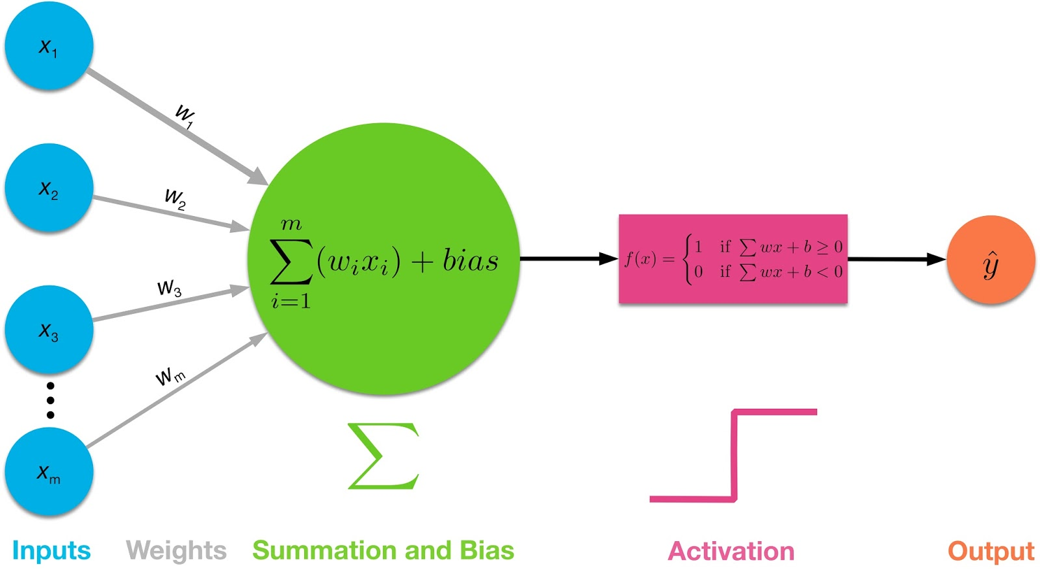
Structural Hyperparameters
The activation function of a neuron is a mathematical function that is applied to the weighted sum of the inputs to the neuron plus a scalar value called bias.
Different activation functions can be used for different layers of the network.
Indeed, it is common to use different activation functions for different layers of the network, but the same activation function will be applied to all the neurons of a single layer.
Activation functions are an important component of neural networks, as they allow the network to model complex relationships between the input and output
The choice of activation function depends on the problem being solved and the architecture of the neural network.
It is an important design decision that can have a significant impact on the performance of the neural network.
where y hat is the output of the neuron, f is the activation function, xi is the input value, wi is the weight of the input, m is the number of inputs, and b is the bias.

Slide 17
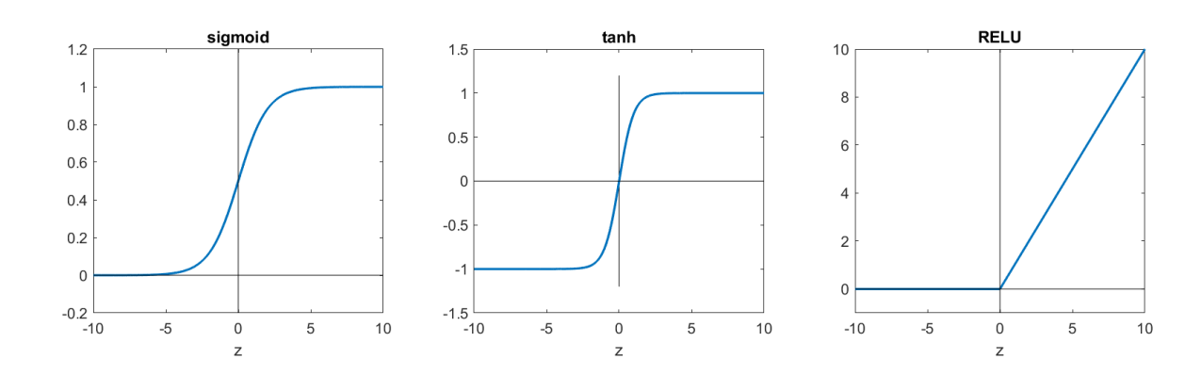
Structural Hyperparameters
Sigmoid: This activation function produces an S-shaped curve and maps the output to the range of 0 to 1. It is often used in the output layer of binary classification problems.
ReLU (Rectified Linear Unit): This activation function returns the input if it is positive, and 0 if it is negative. It is widely used in hidden layers as it is computationally efficient and helps prevent the vanishing gradient problem.
Tanh (Hyperbolic Tangent): This activation function maps the output to the range of -1 to 1 and is similar to the sigmoid function. It is often used in hidden layers of the neural network.
Softmax: used in the output layer of a neural network for multi-class classification problems. It maps the output to a probability distribution over the output classes.
ELU (Exponential Linear Unit): This activation function has a smooth exponential curve for negative inputs. It helps address the vanishing gradient problem and can lead to better accuracy compared to ReLU.
Linear activation functions: here the neuron can only model linear relationships between the inputs and outputs, which limits the expressive power of the neural network. This activation function is typically used in regression problems, where the output of the neural network is a continuous value.

Slide 18
Training Hyperparameters
Learning rate: Determines how much the weights are updated during training.
Batch size: The number of training examples used in each forward and backward pass. The training examples are divided into smaller batches, and the weights are updated after processing each batch.
Number of epochs: The number of times the entire training set is passed through the network.
Regularization: Techniques such as L1 and L2 regularization can be used to prevent overfitting and improve generalization performance.
Dropout: A regularization technique that randomly drops out neurons during training to prevent overfitting.
Optimization algorithm: Determines how the weights are updated during training, such as stochastic gradient descent, Adam, or Adagrad.

Slide 19
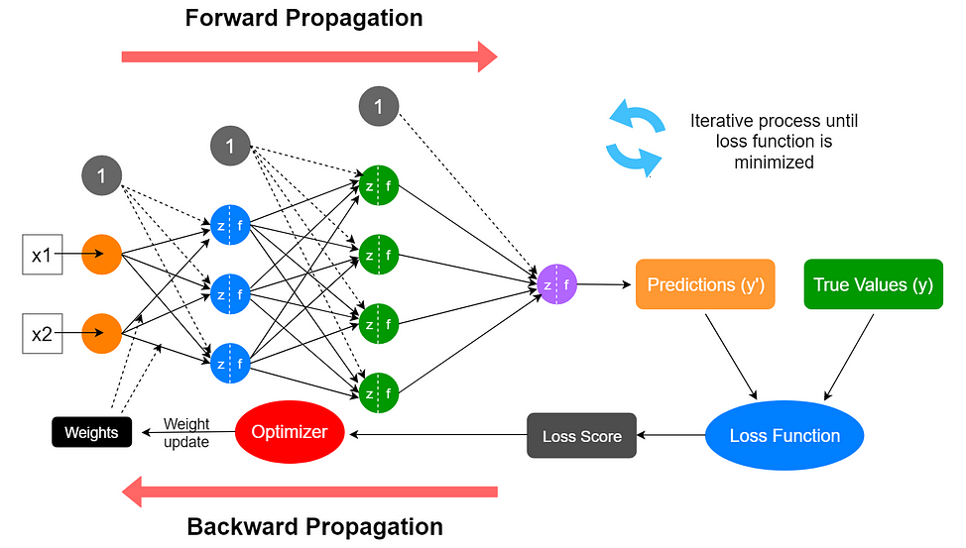
Training Hyperparameters
The gradient descent algorithm processes the training data in small batches rather than all at once to reduce the computational requirements and to improve convergence.
An epoch refers to one complete iteration through the entire training dataset. In other words, the algorithm has seen all the training examples once during an epoch. After processing all the batches once, an epoch is completed. The number of epochs determines how many times the algorithm will go through the entire dataset.
It is important to set the number of epochs appropriately too few epochs may result in underfitting (i.e., the model is too simple and cannot capture the underlying patterns in the data), while too many epochs may lead to overfitting (i.e., the model is too complex and memorizes the training data instead of generalizing to new data).

Slide 20
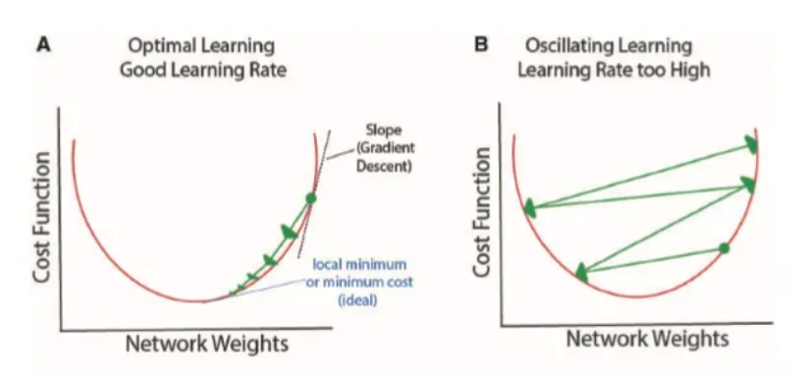
Training Hyperparameters
The size of the update is determined by the learning rate, which is a hyperparameter that controls how much the weights and biases are changed at each iteration in response to the error calculated by the cost function during backpropagation.
It affects the performance and speed of the training process. If the learning rate is too high, the weights and biases may oscillate back and forth (B), and the model may fail to converge to a good solution. If the learning rate is too low, the training process may be very slow and may get stuck in a local minimum.

Slide 21
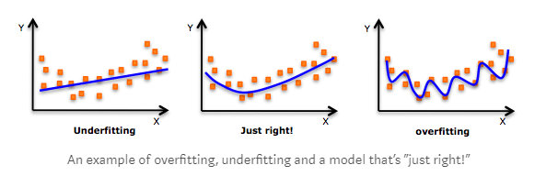
Overfitting
Overfitting refers to the phenomenon where a neural network models the training data very well but fails when it sees new data from the same problem domain.
Overfitting is caused by noise in the training data that the neural network picks up during training and learns it as an underlying concept of the data.
Usually overfitting occurs in more complex neural network models (many layers, many neurons).
The complexity of the neural network can be reduced by using L1 and L2 regularization as well as dropout

Slide 22
Training Hyperparameters
Regularization refers to a set of different techniques that help to control the complexity of the network and prevent overfitting, leading to better generalization performance on unseen data.
L1 and L2 Regularization
In this technique, a penalty term is added to the cost function that is being optimized during training.
The penalty term is based on the weights of the network, and it encourages the network to use smaller weights.
This, in turn, reduces the complexity of the network and helps prevent overfitting.
Regularization L1 adds a penalization proportional to the absolute values of weights and forces the weight parameters to become zero
Regularization L2 adds a penalization proportional to the squared value of weights and forces the weight parameters towards zero (but never exactly zero)
L1 regularization L2 regularization helps to produce smaller weight parameters that make some neurons neglectable → neural network becomes less complex → less overfitting

Slide 23
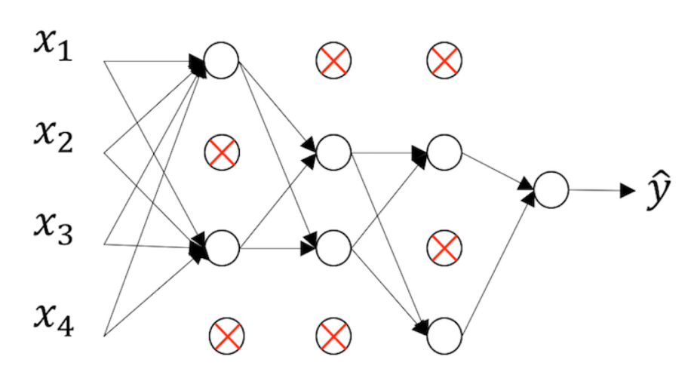
Training Hyperparameters
Dropout
In this technique, random neurons are temporarily removed from the network during training. This forces the network to learn more robust features that are not dependent on the presence of specific neurons.
Being a regularization techniques, randomly dropping the neurons helps to control the complexity of the network and to prevent overfitting, leading to better generalization performance on unseen data.
During the dropout, some neurons get deactivated with a random probability P → Neural network becomes less complex → less overfitting
Every layer has a probability P or dropout rate of having its neuron dropped.
Different layers may have different probabilities.

Slide 24
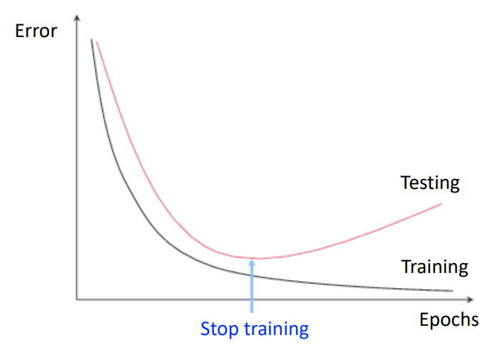
Training Hyperparameters
Early Stopping
In this technique, the training process is stopped before the network is fully trained. This is done by monitoring the performance of the network on a validation set. When the performance on the validation set stops improving, the training process is stopped. This helps prevent overfitting by stopping the network from memorizing the training data.
The idea is to stop training before testing error increases, keeping so the weights smaller and controlling the complexity of the network to prevent overfitting
As the training process progresses, some weights usually grow up, If we stop earlier, we’ll keep weights smaller.
Also, early stopping requires less computational power than other methods.

Slide 25
Training Hyperparameters
Normalization
This technique is a data pre-processing tool used to bring the numerical data to a common scale without distorting its shape.
Generally, when we input the data to a machine or deep learning algorithm we tend to change the values to a balanced scale. The reason we normalize is partly to ensure that our model can generalize appropriately.
This method is used to make training of artificial neural networks faster and more stable through normalization of the layers' inputs by re-centering and re-scaling.
This happens a process adding extra layers in deep neural network. The new layer performs the standardizing and normalizing operations on the input of a layer coming from a previous layer.
By normalizing all of our inputs to a standard scale, we're allowing the network to more quickly learn the optimal parameters for each input node.

Slide 26
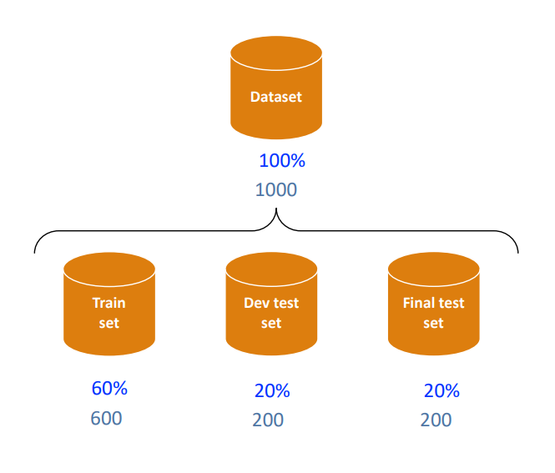
Training/Testing/validation
Training set: adjust the parameters: weights and bias.
Development or validation (test) set: tune the model: hyperparameters.
(Final) test set: Reliability.
Training set is the data employed to adjust the parameters in the training process: weights and bias (parameters).
Development or validation (test) set is employed to measure how well the model classifies unseen data and tune the hyperparameters (e.g. learning rate) accordingly.
(Final) test set is never presented until the model is totally finished (tuned) to predict how the model fits the problem.
Measuring performance
Accuracy is percentage of correctly classified examples.

Slide 27
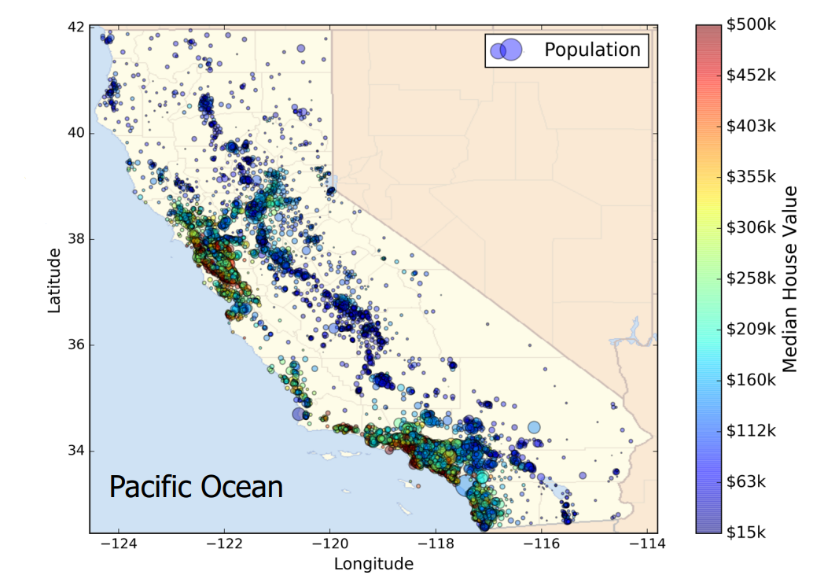
Case Study
California housing dataset Median house
CLASSIFICATION PROBLEM
Dataset:
m=20640 examples corresponding to districts in California ranging from 600 to 3000 people.
nx=9 attributes.
Label = Median house value
ny= 3 classes (classification)
R. K. Pace & R. Barry, “Sparse Spatial Autoregressions,” Statistics & Probability Letters 33, no. 3 (1997): 291–297.

Slide 28
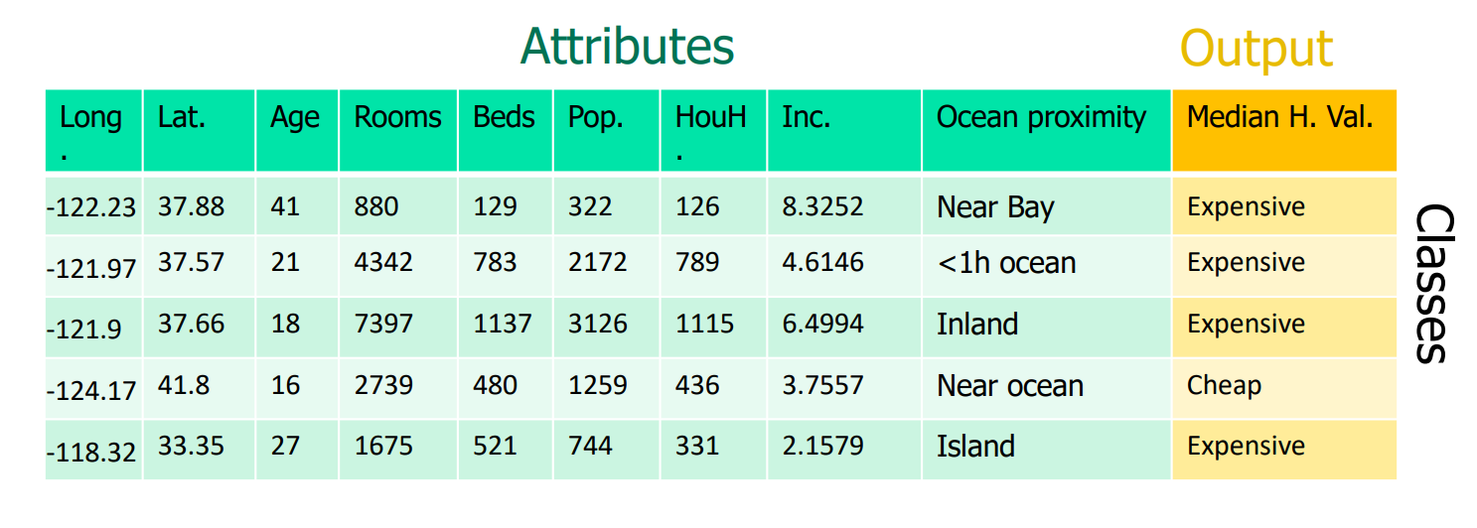
Case Study
California housing dataset Median house classification problem
Attributes:
longitude, latitude, median age, total rooms, total bedrooms,
population, households, median income, ocean proximity.
Median house value:
Cheap [15, 141.3];
Averaged [141.4, 230.2];
Expensive [230.3, 500] th$.

Slide 29
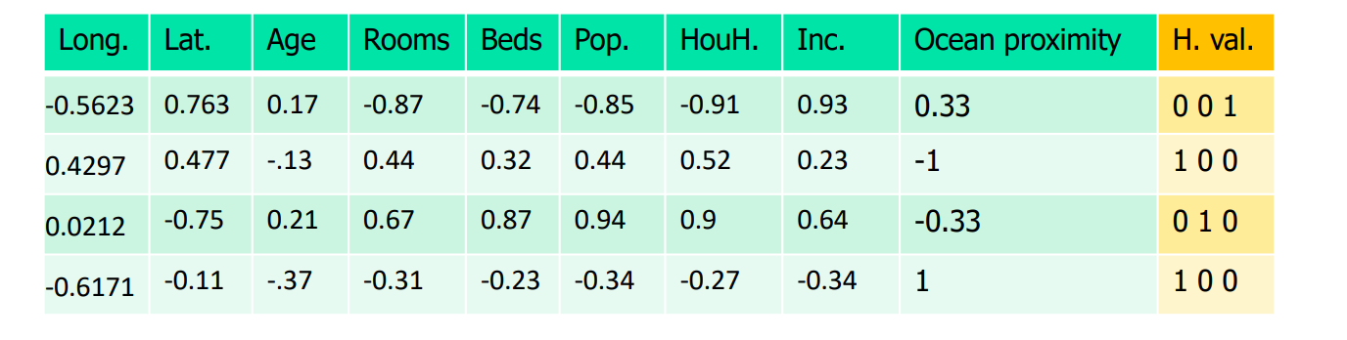
Case Study
California housing dataset Median house classification problem
Cleaning and Preparing data:
1. Total_bedrooms attribute has 207 missing values, (na or nan), which are removed since they are very little compared to the whole dataset.
2. ISLAND has only 5 samples, not enough to generalize.
This class is removed.
3. Attributes are individually re-scaled, normalized with a min-max scaling within the range [-1,1]: x-(max/2) / (max-min)/2.
4. The class are hot encoded
One-hot encoded labels
Cheap: 1,0,0
Averaged: 0,1,0
Expensive: 0,0,1
5. The correlation matrix between all pairs of attributes has been calculated to visualize their dependencies. The results achieved report that total_rooms, total_bedrooms, population and households are highly (positive) correlated.

Slide 30
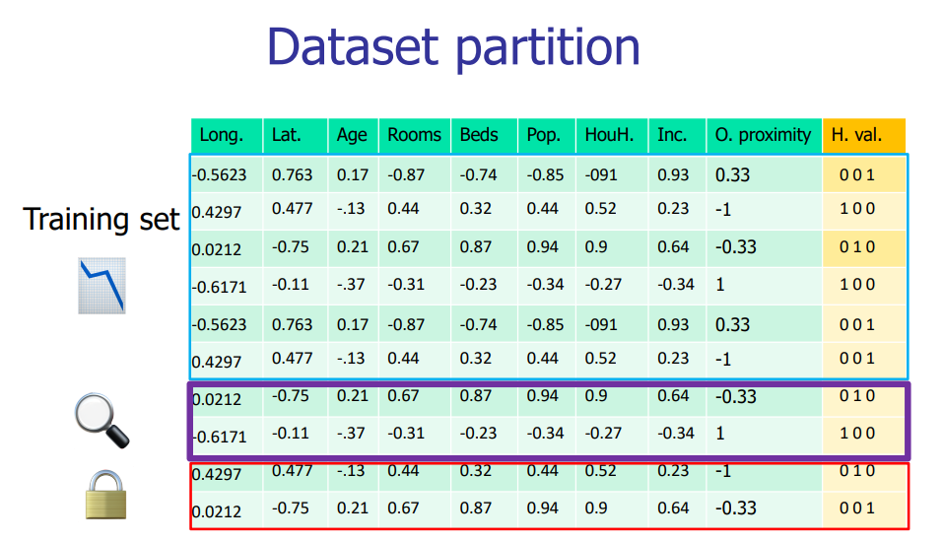
Case Study
California housing dataset Median house classification problem
Training set: adjust the parameters: weights and bias.
Development or validation (test) set: tune the model: hyperparameters.
(Final) test set: Reliability.
Finally, a partition of the dataset is created with three subsets: 16342 (80%) samples for training the neural model; 2043 (10%) for development testing;
2043 (10%) for final testing purposes.

Slide 31
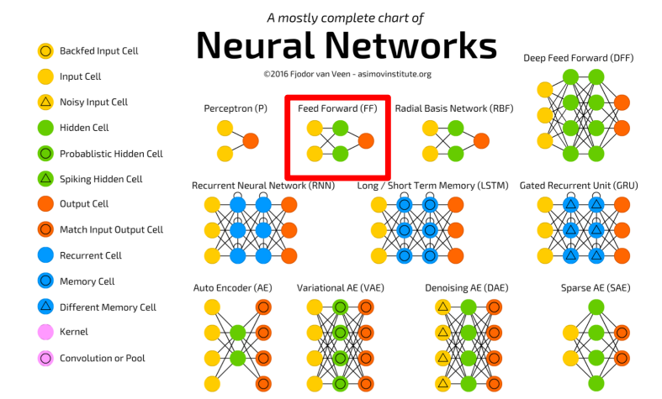
ANN type

Slide 32
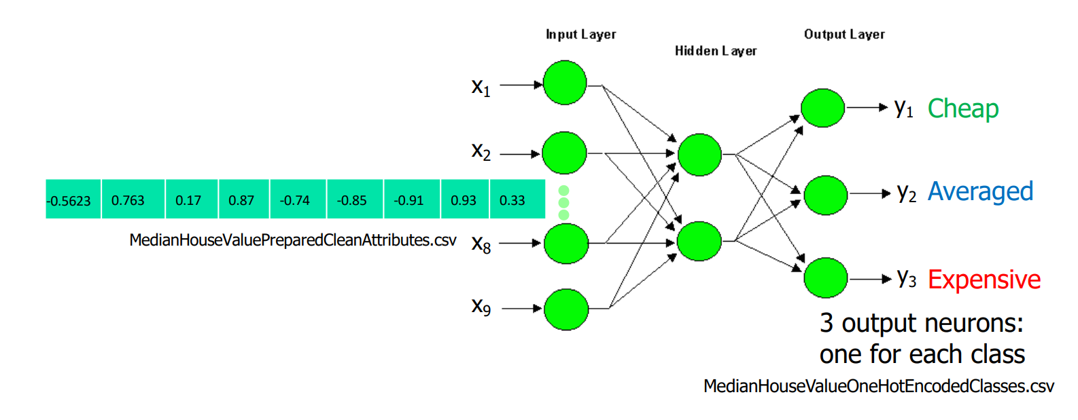
ANN Architecture
Neural architecture Hyperparameters: 1000 hidden neurons
Learning rate = 0.1
Batch size = 500
Activation functions: tanh and softmax
1000

Slide 33



Hands on
One Hidden Layer with Tensorflow.ipynb

Slide 34
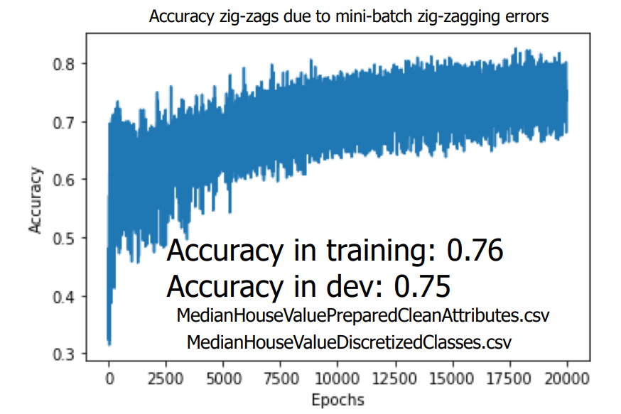
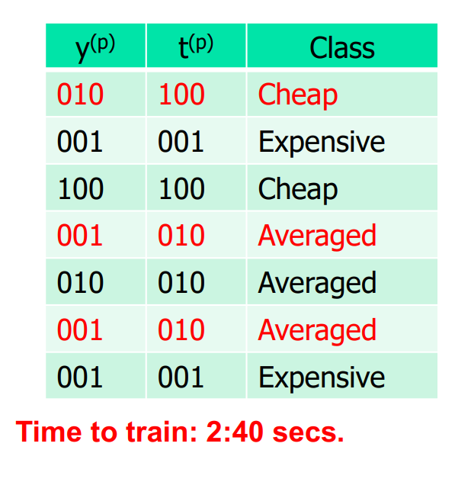
Hands on results
16342 samples for training;
2043 for development;
Test samples are not considered.
One-hidden layer with tanh results
Hyperparameters: Stop condition: 20,000 iterations
Learning rate =0.1
Mini-batch size = 500
Hidden neurons = 1,000

Slide 35
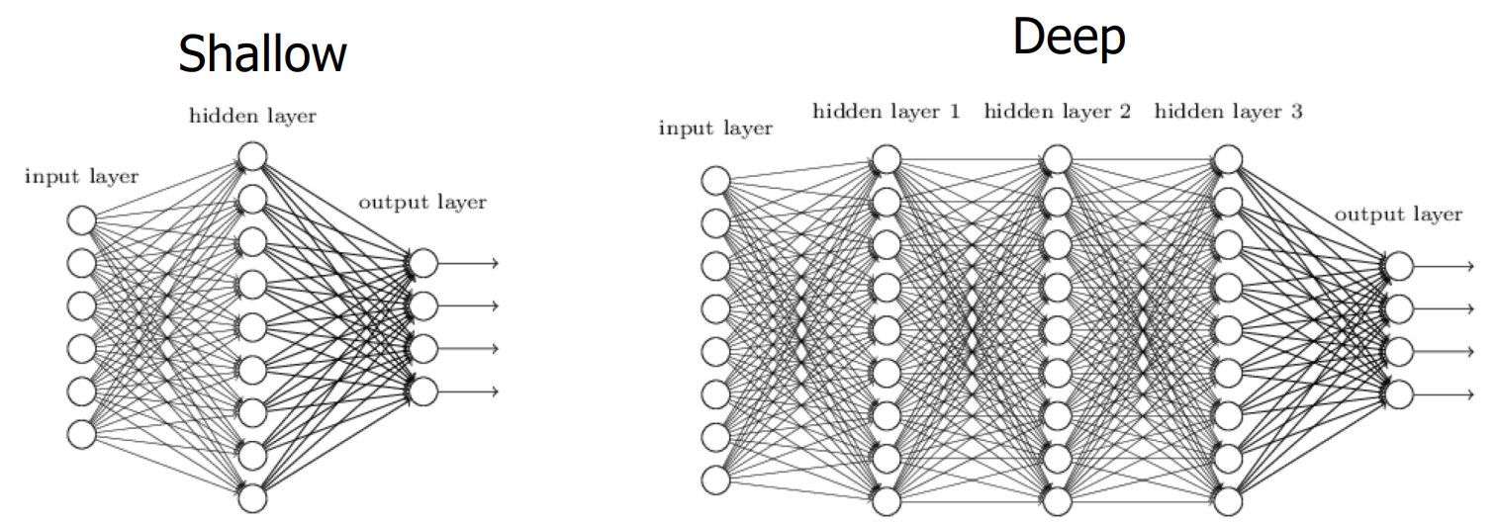
What’s next?

Slide 36

Complementary Readings
A Beginner's Guide to Python
Why ANN are hard to train?
The problem of exploding or vanishing gradients
Weights optimizations – SGD
Vanishing/Exploding gradient
Addestramento rete neurale in parole semplici
Pillole di analisi 2: il gradiente
How to initialize the weights in python
Preventing Overfitting in ANN
Normalization to improve deep learning models

Slide 37
Work Groups Plan
The following table displays the working groups that will perform the ANN Optimization assignment in Python.
Each group will provide a short presentation on the achieved results on 26/05/2023.
Name | Members
Group A | Jacopo Esposito, Vittorio Zoccola,
Group B | Angelo Pio Tuccillo, Gennaro di Stasio, Martina Ruggiero
Group C | Davide Fiorentini, Pasquale Ruopolo, Fabrizio Zheng
Group D | Rosa Izzo, Serena Fucile, Sarconio Daniele
Group E | Francesco Palmisano, Andrea Cappabianca , Milena Aiello

Slide 38
THANK YOU! Any Questions?

